Slide 1
Fourier Transform
厦门大学 罗塞雨

Slide 2
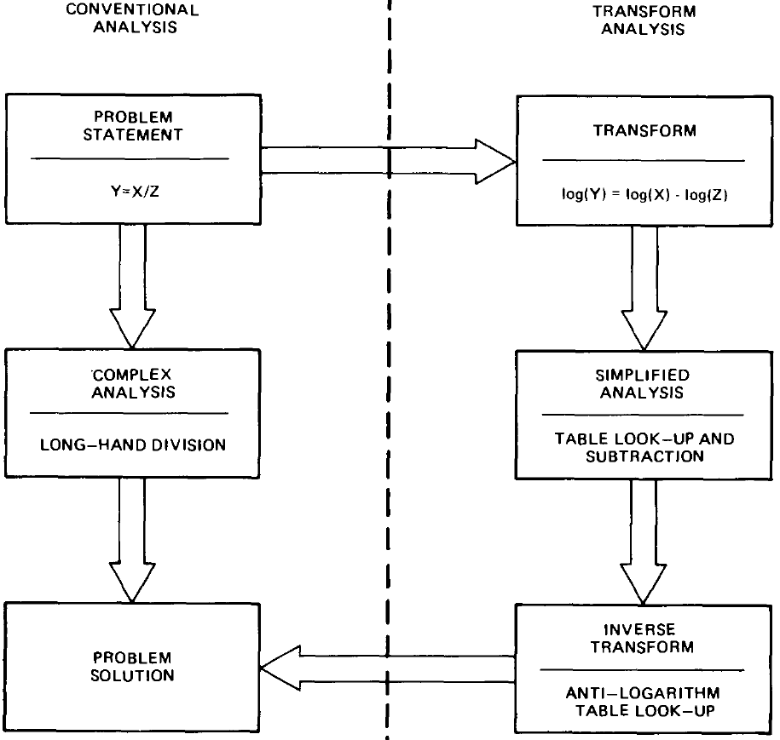
1. Introduction Transform Analysis
Flow diagram relationship of
conventional and transform analysis

Slide 3
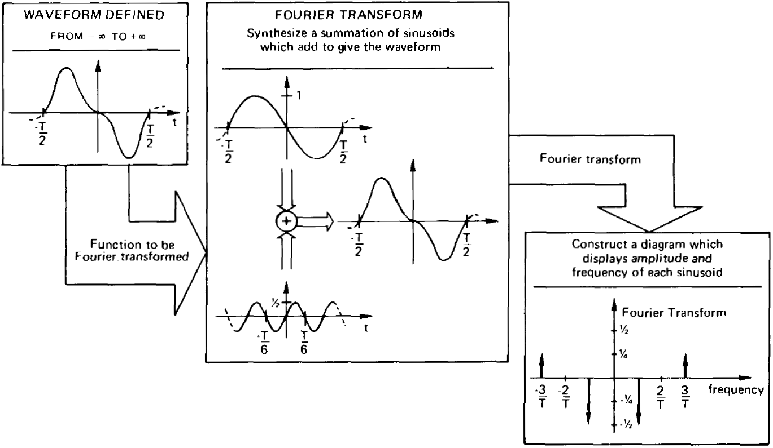
Introduction Basic Fourier Transform analysis
Just for graphical explanation, the transform isn’t correct!
Interpretation of the Fourier transform

Slide 4
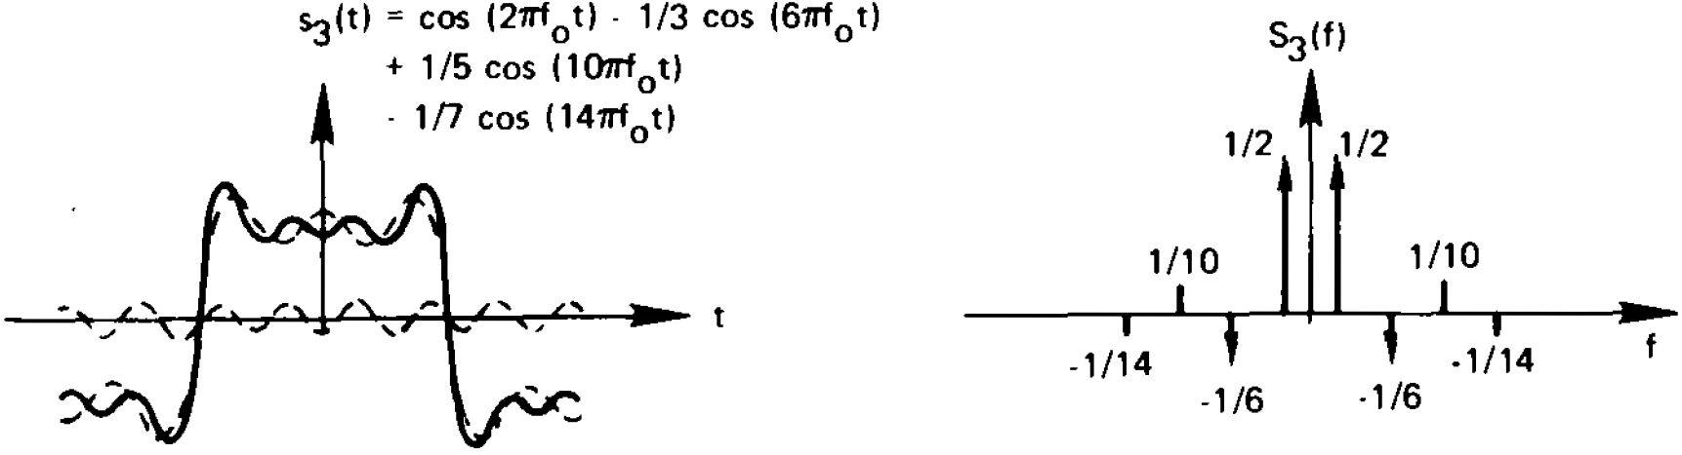
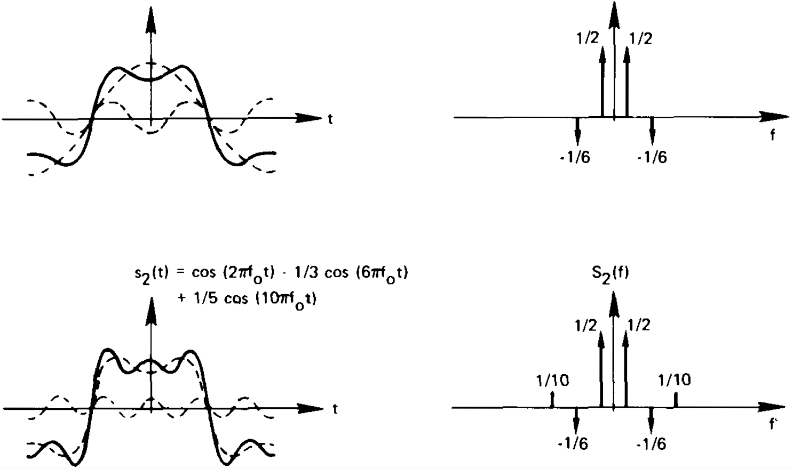
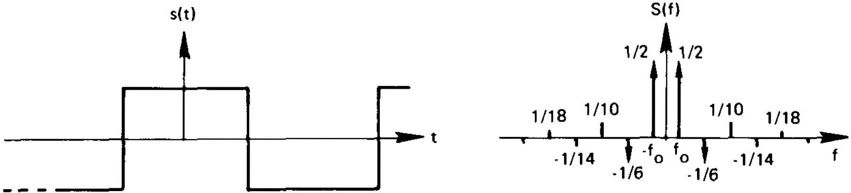
Fourier transform of a square wave function (Fourier series)

Slide 5
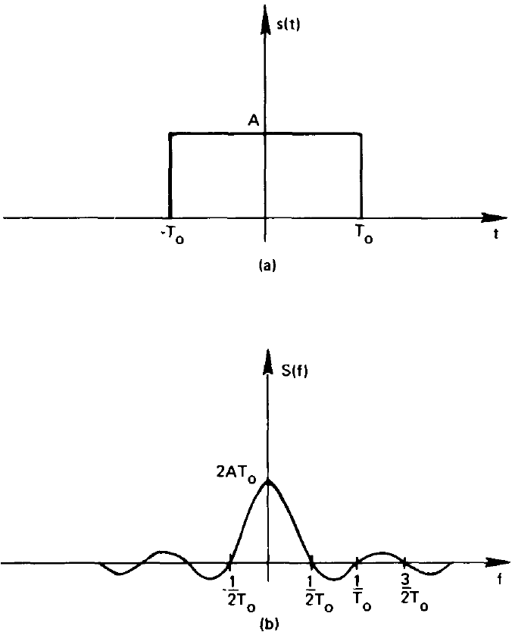
Fourier transform of a pulse waveform

Slide 6
Introduction The Ubiquitous Fourier Transform
Linear Systems. The Fourier transform of the output of a linear system is given by the product of the system transfer function and the Fourier transform of the input signal.
Antennas. The field pattern of an antenna is given by the Fourier transform of the antenna current illumination.
Optics.
Random process. The power density spectrum of a random process is given by the Fourier transform of the auto-correlation function of the process.
Probability. The characteristic function of a random variable is defined as the Fourier transform of the probability density function of the random variable.
Quantum physics. The uncertainty principle in quantum theory is fundamentally associated with the Fourier transform since particle momentum and position are essentially related through the Fourier transform.
Boundary-Value Problems. The solution of partial differential equations can be obtained by means of the Fourier transform.

Slide 7
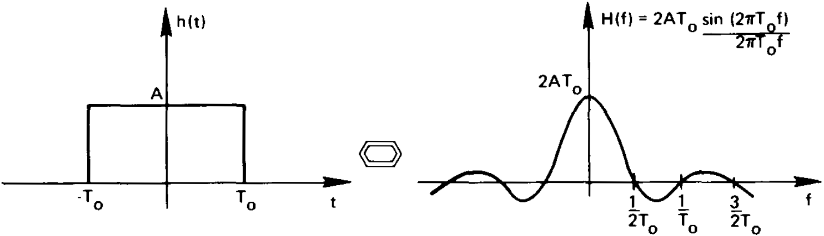
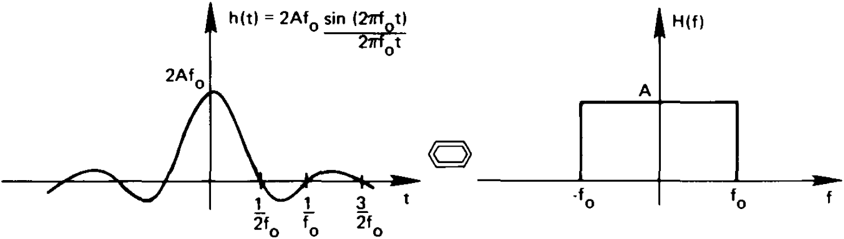
2. The Fourier Transform

Slide 8
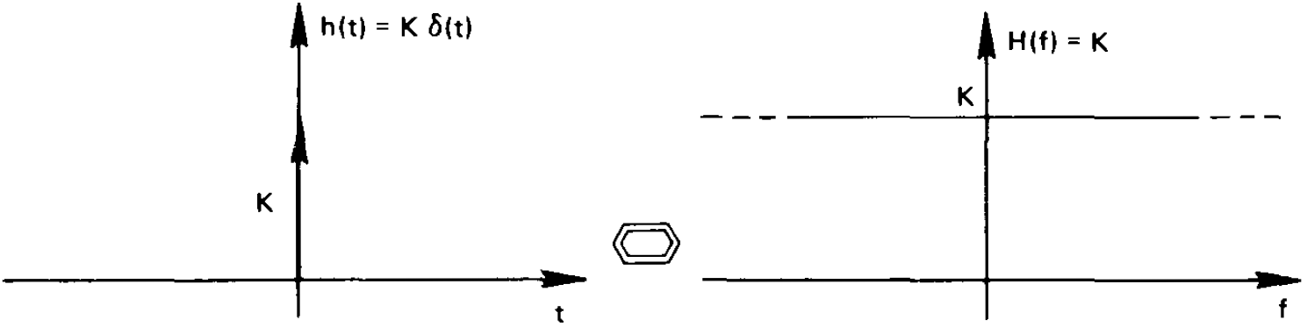
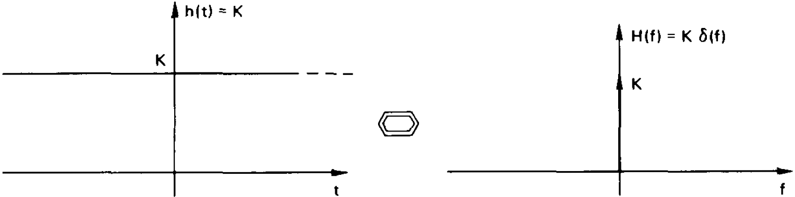
Fourier transform of an impulse function
Fourier transform of a constant amplitude waveform

Slide 9
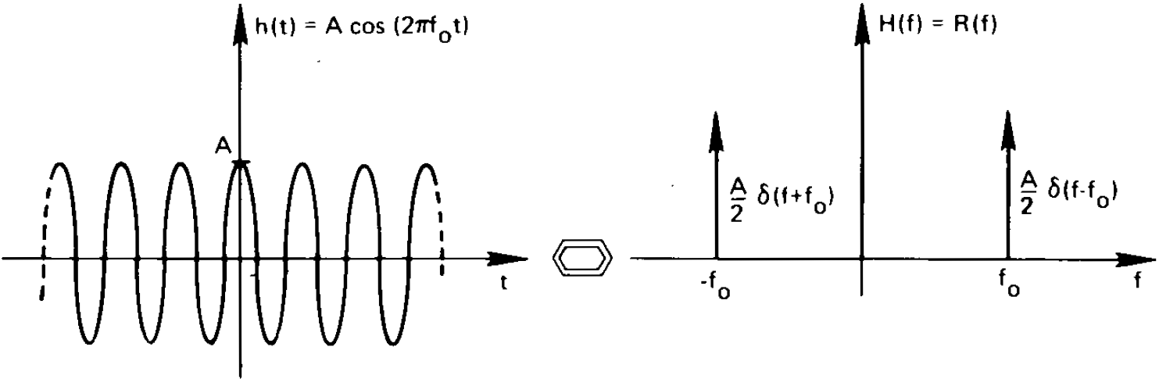
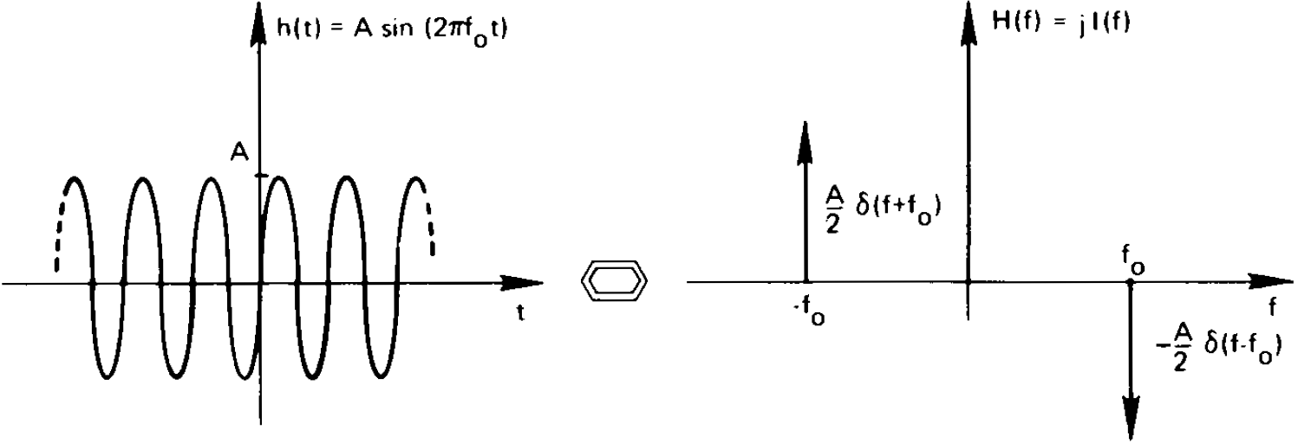
Note that the Fourier transform is imaginary

Slide 10
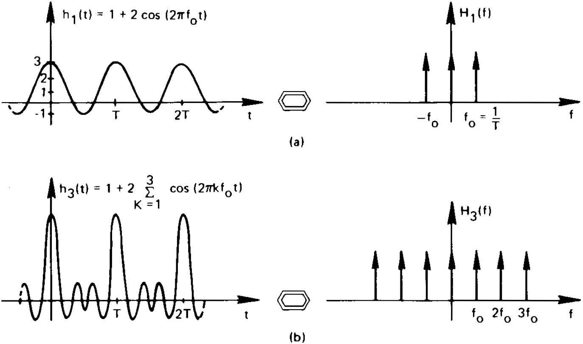
Graphical development of the Fourier transform of a sequence of equal distant impulse function

Slide 11
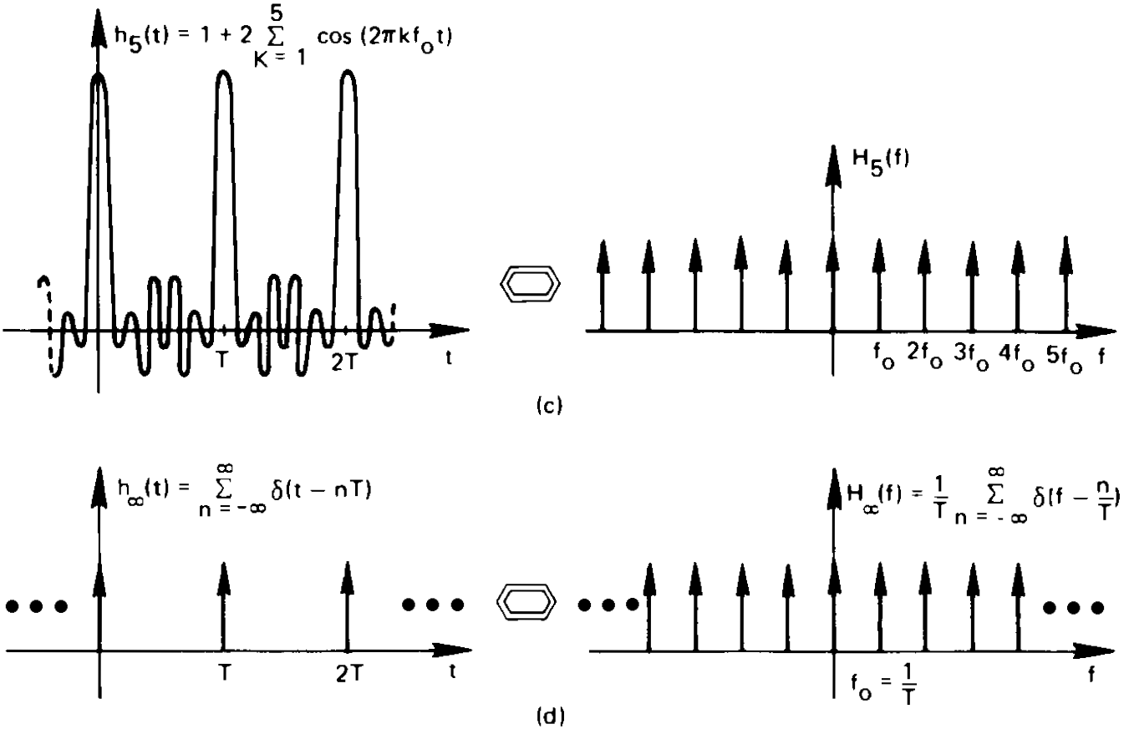

Slide 12
Inversion Formula Proof

Slide 13
Alternate Fourier Transform Definitions

Slide 14
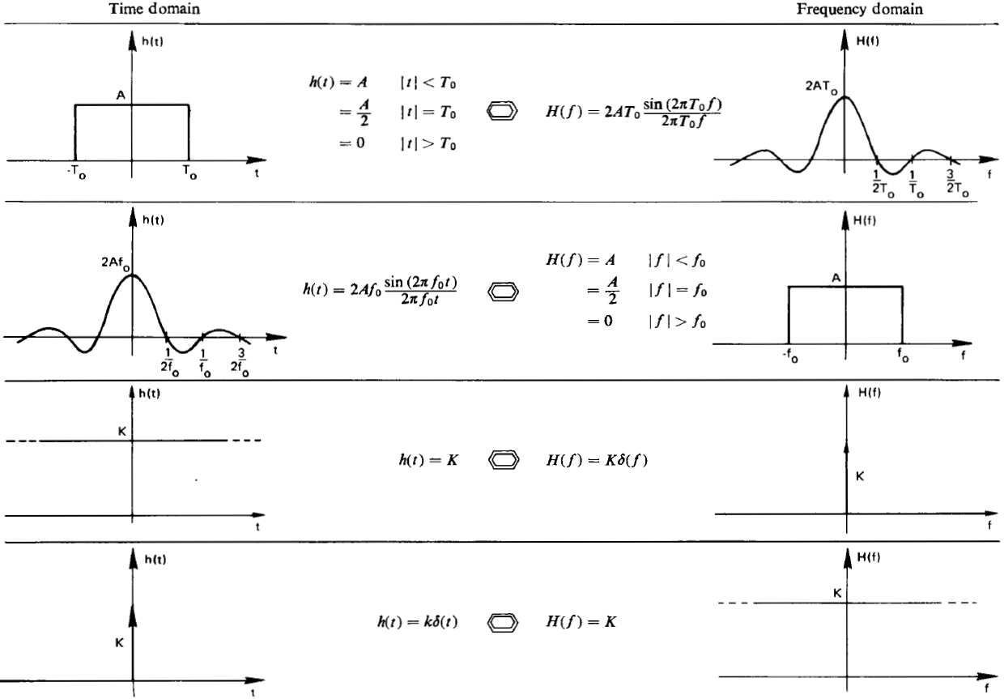
Conclude

Slide 15
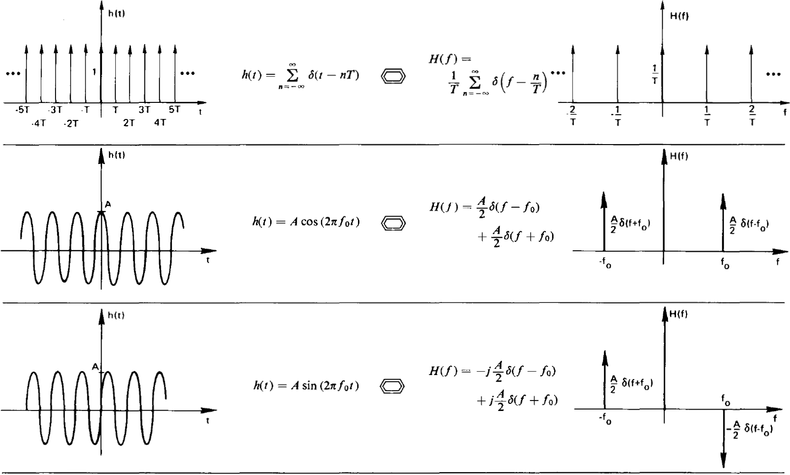
The Fourier transform of a sequence of equal distant impulse functions
is another sequence of equal distant impulses
To be continued

Slide 16
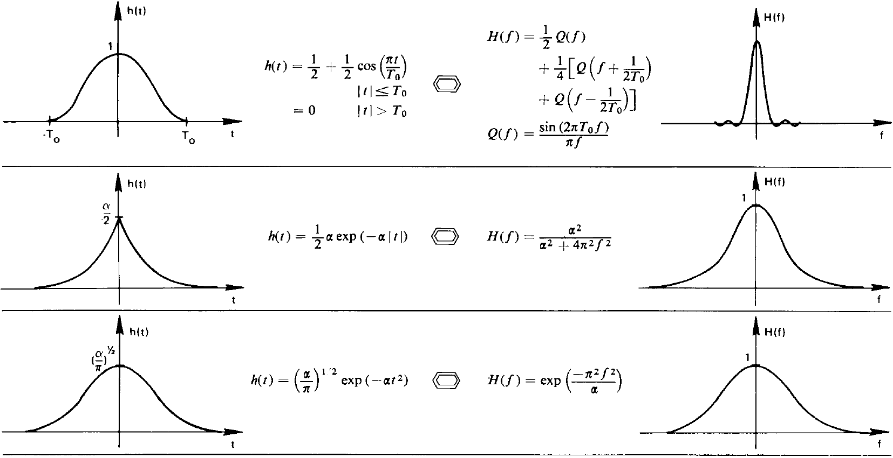

Slide 17
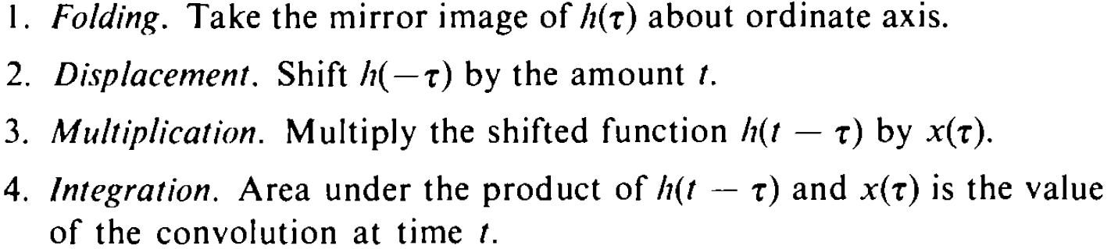
3. Convolution and Correlation (1). Convolution
Summarizing steps:

Slide 18
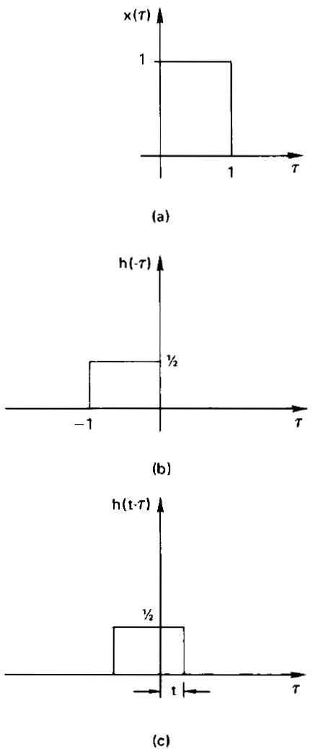
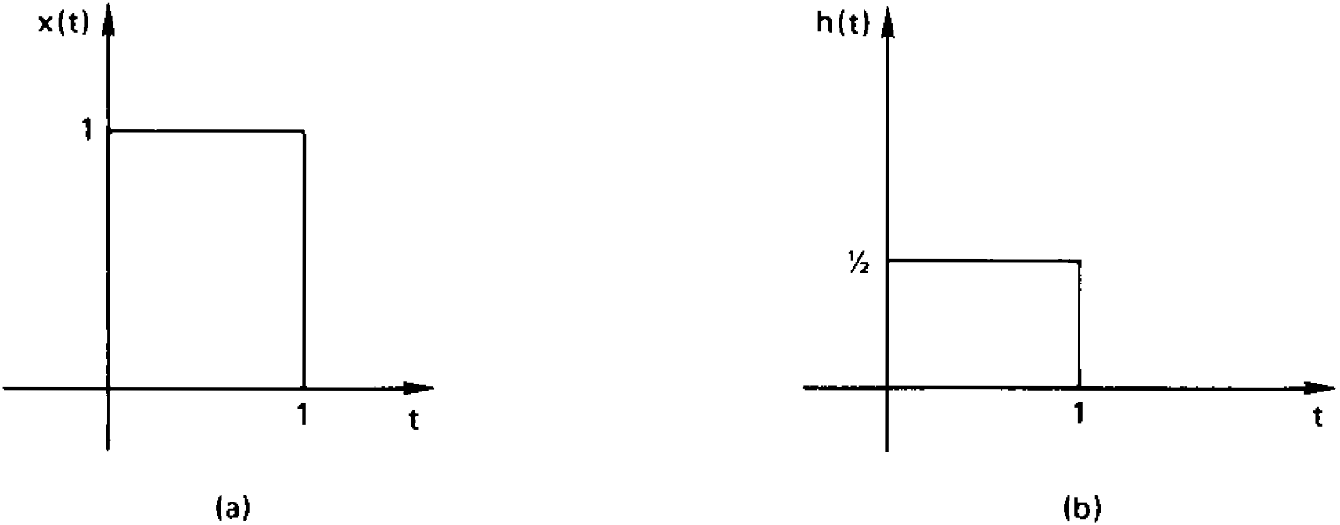
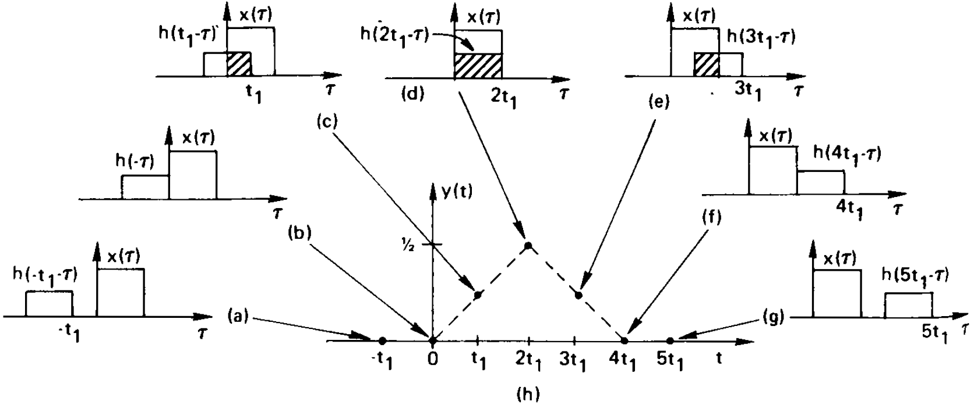
Graphic Evaluation of the Convolution Integral
1. Example waveforms to convolution
3. Graphic example of convolution
2. Graphic description of folding operation

Slide 19
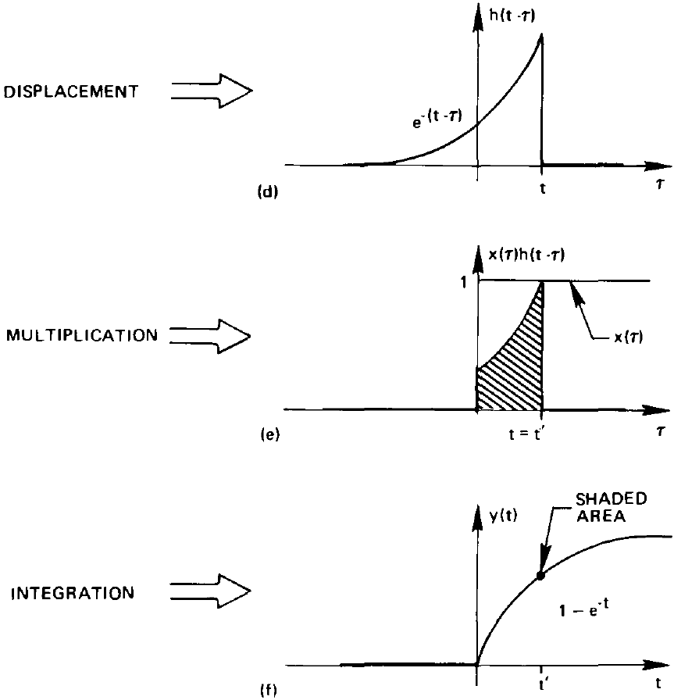
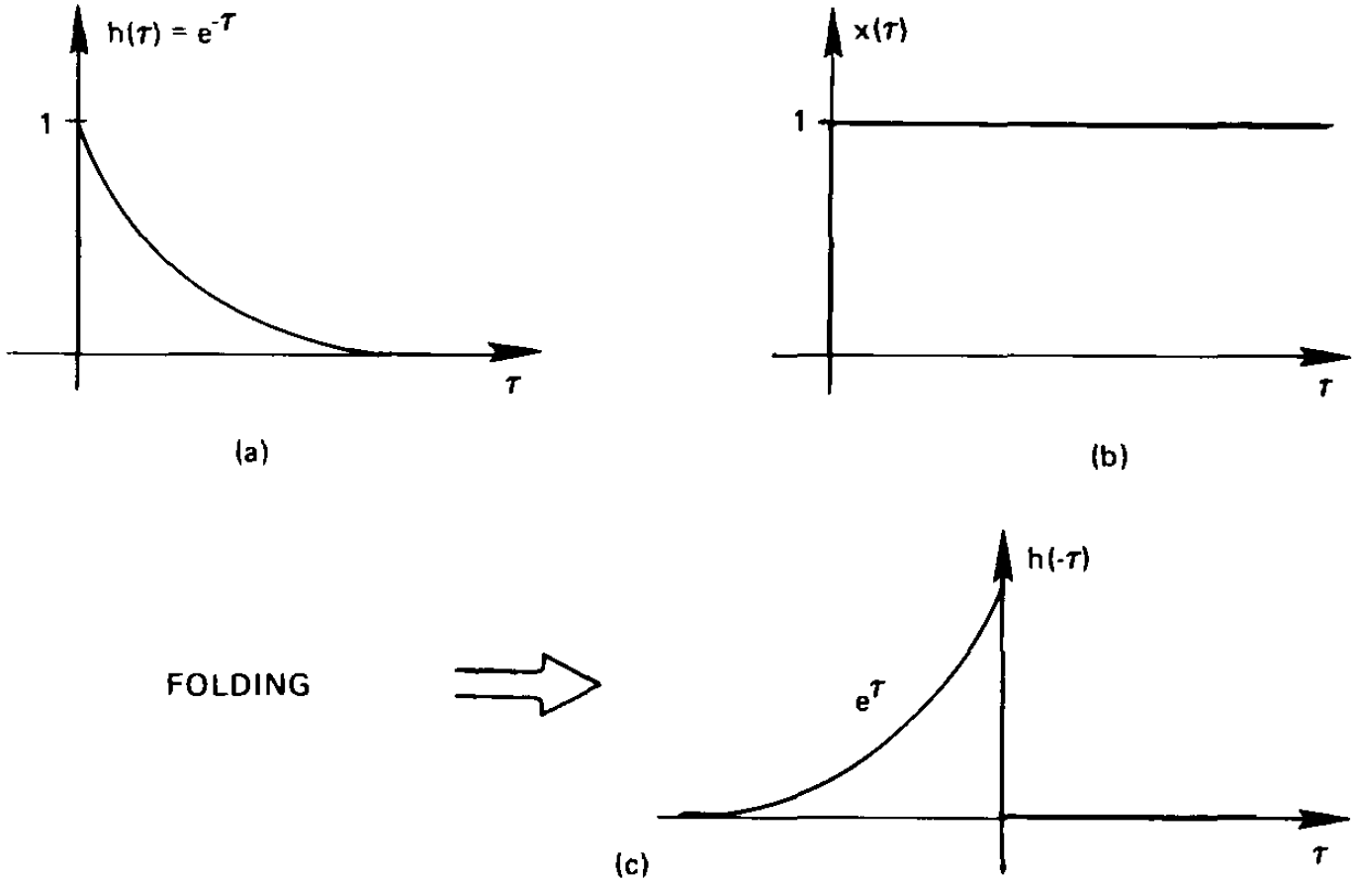
Another example of Convolution
Convolution procedure: folding, displacement, multiplication and integration

Slide 20
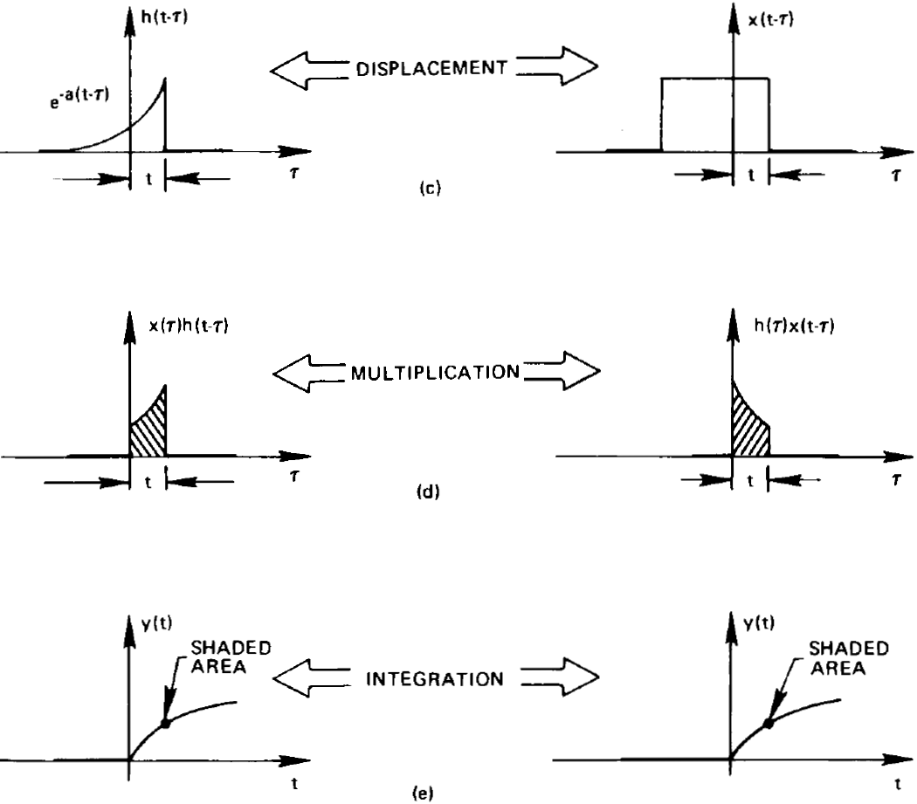
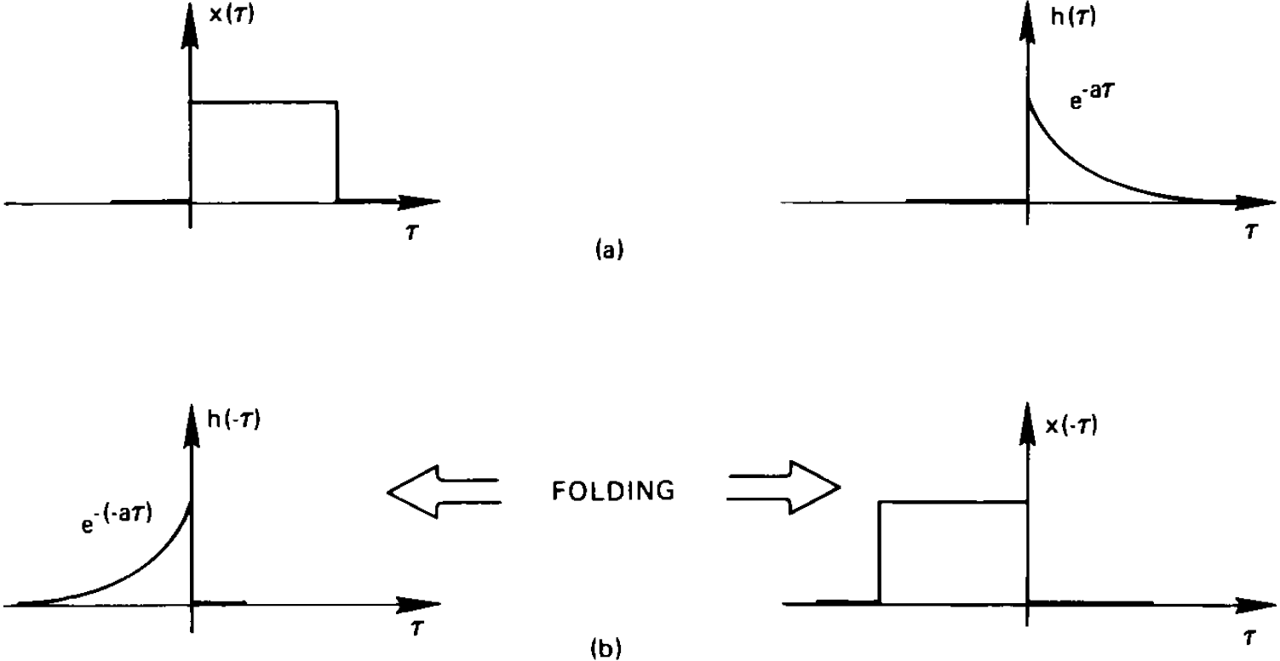
Alternate Form of the Convolution Integral

Slide 21
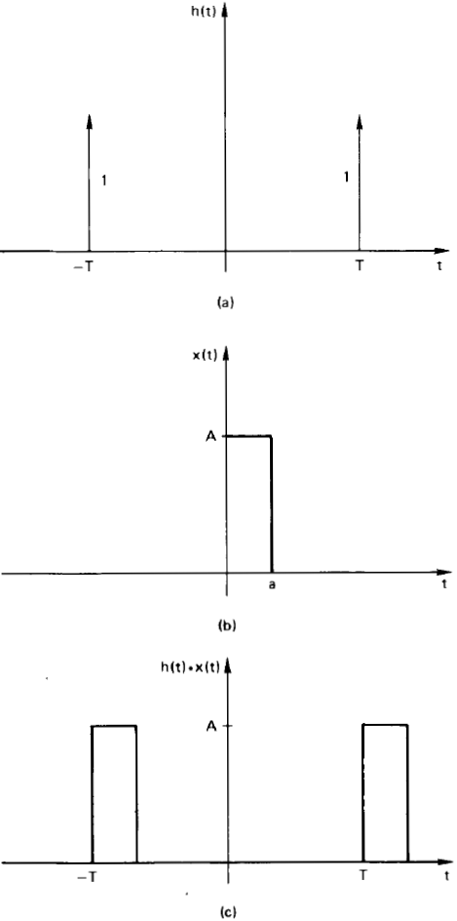
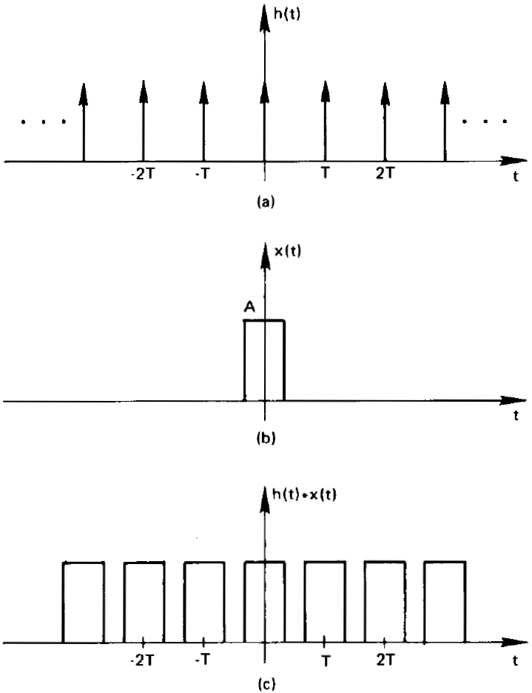
Convolution Involving Impulse Functions
Illustration of convolution
involving impulse functions

Slide 22
Convolution Theorem

Slide 23
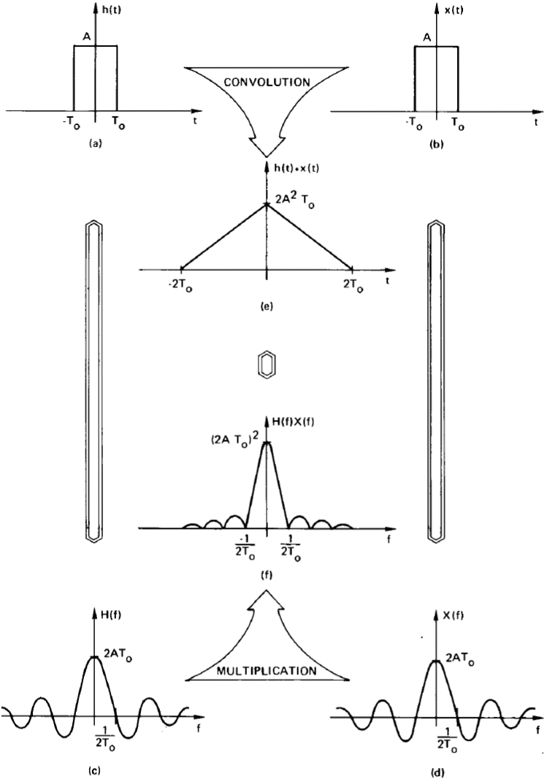
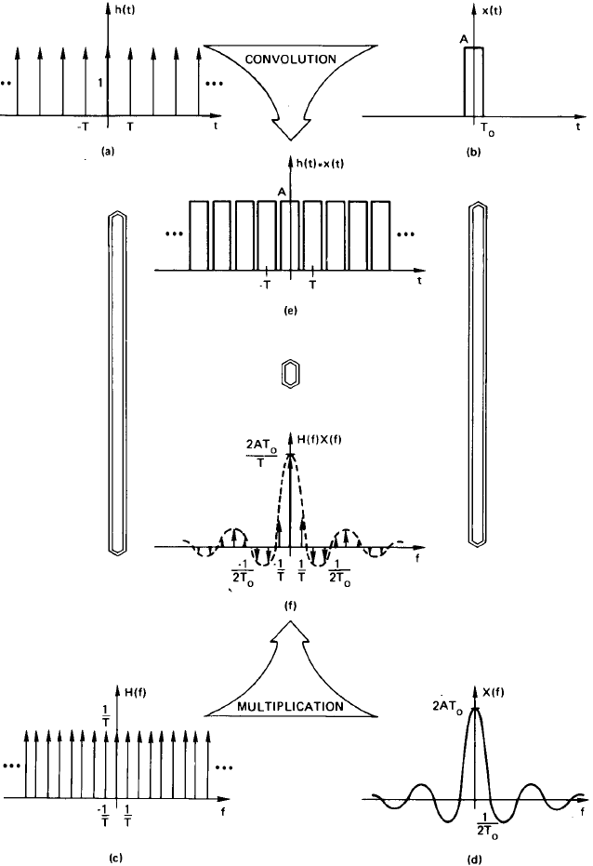
Graphical example of the convolution theorom
Example application of the convolution theorem

Slide 24
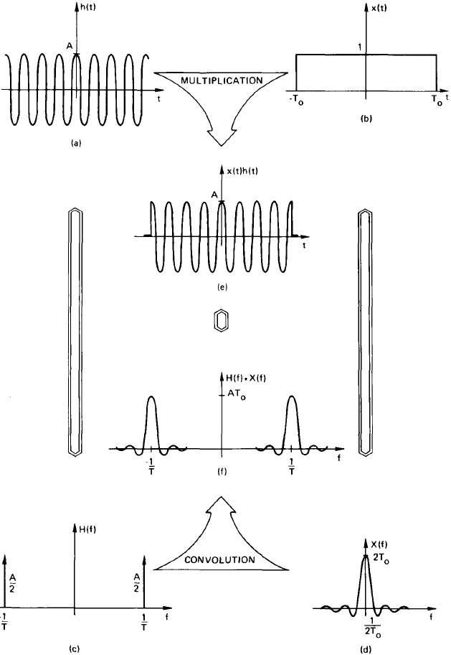
Frequency Convolution Theorem

Slide 25
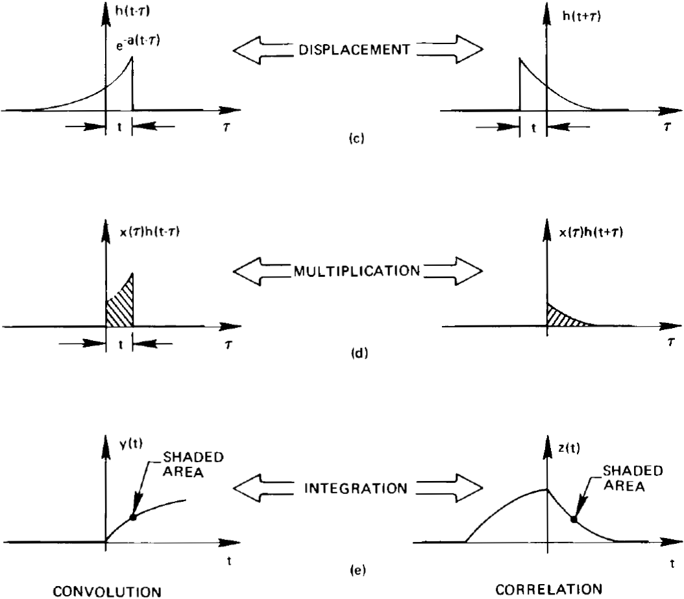
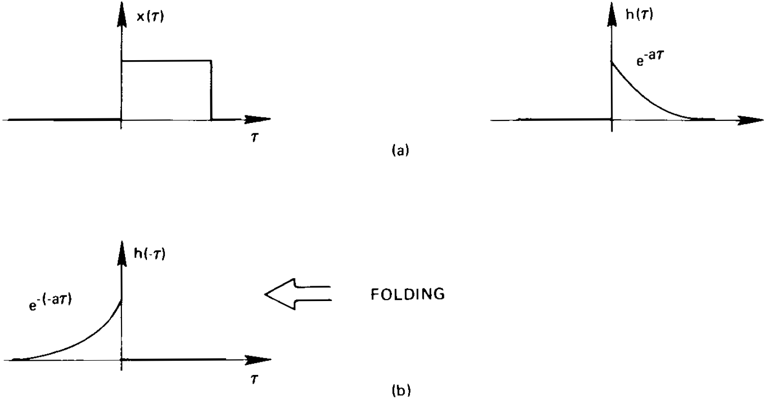
3. Convolution and Correlation (2). Correlation
Graphical comparison of convolution and correlation

Slide 26
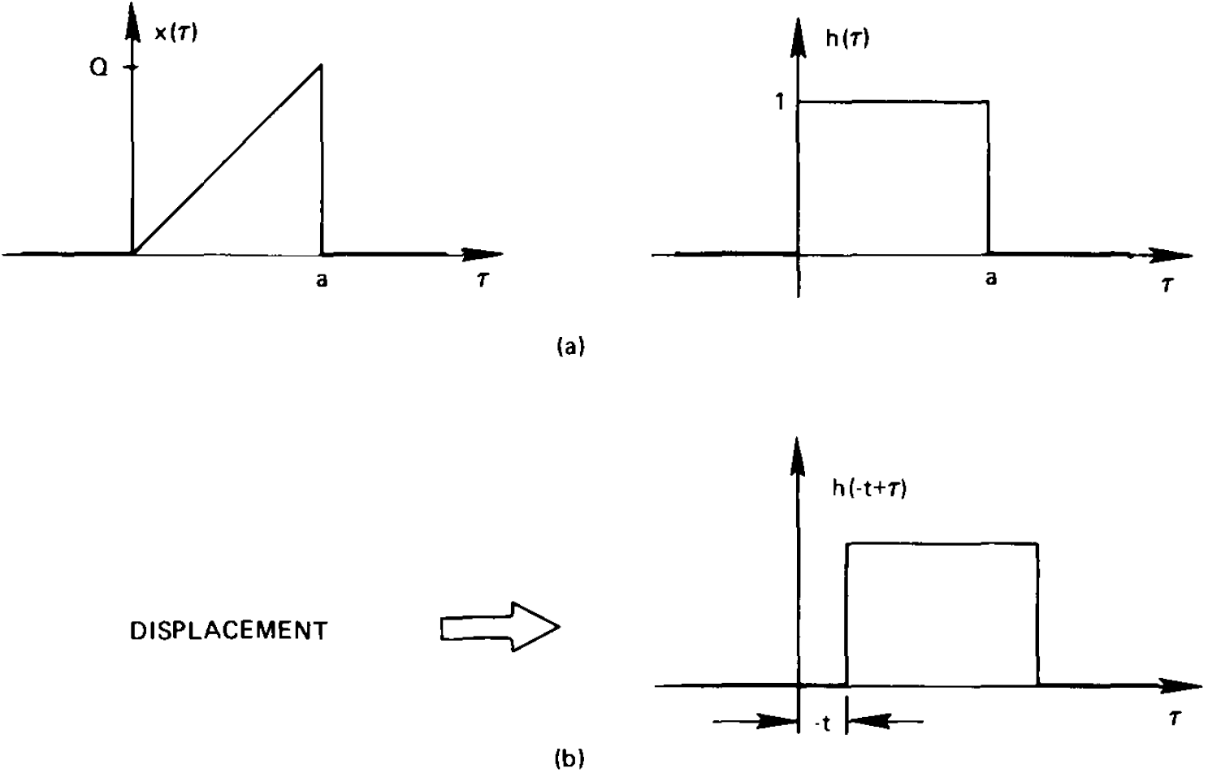
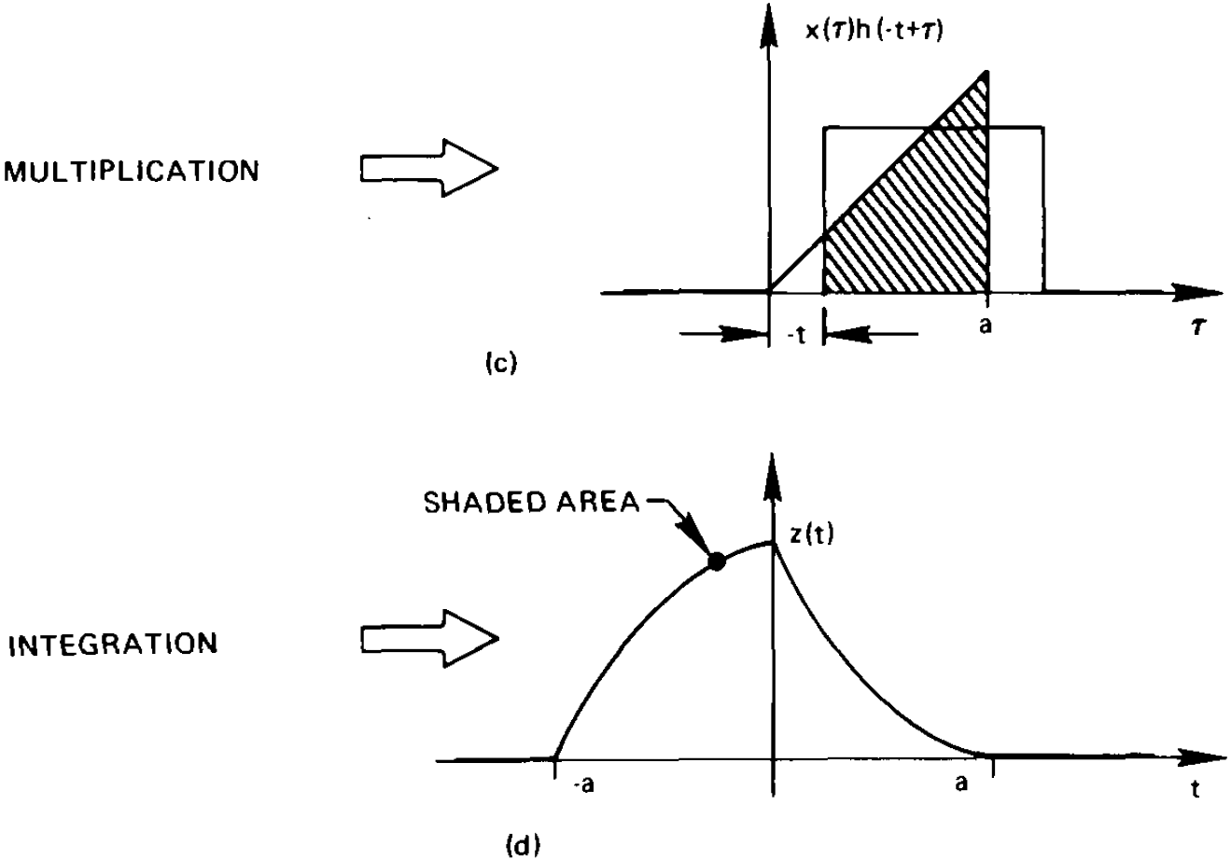
Correlation procedure: displacement, multiplication and integration
For the special case where either x(t) or h(t) is an even function, convolution and correlation are equivalent;
This follows since an even function and its image are identical and, thus, folding can be eliminated from the
Steps in computing the convolution integral.

Slide 27
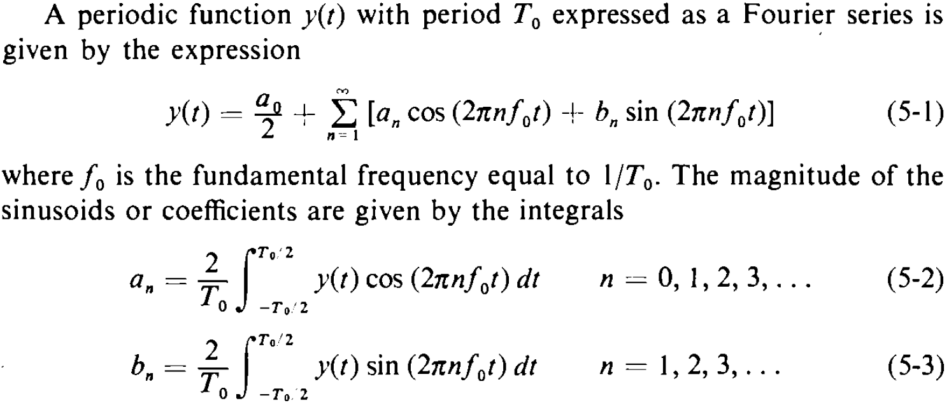
4. Fourier Series and Sampled Waveforms (1). Fourier Series
Notes:
Chapter 5

Slide 28
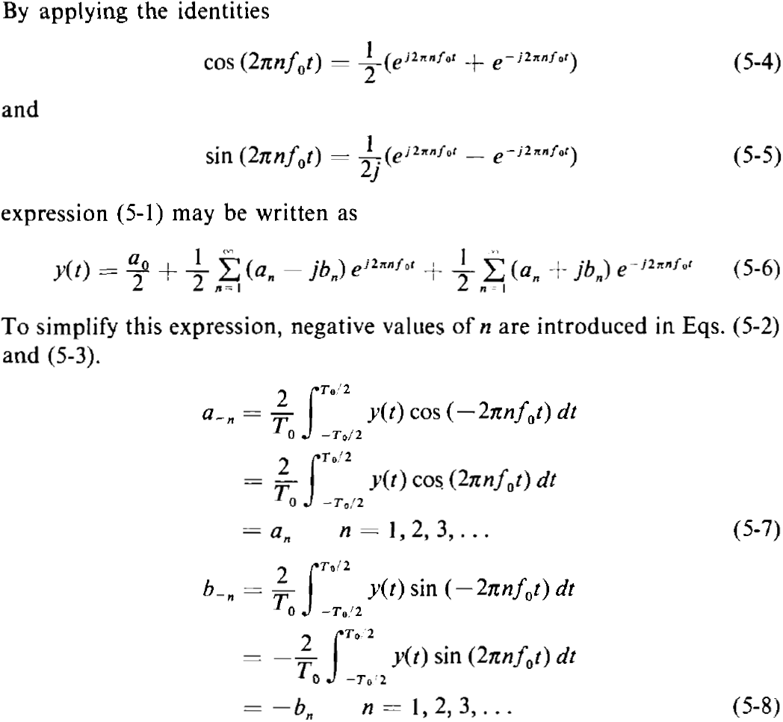
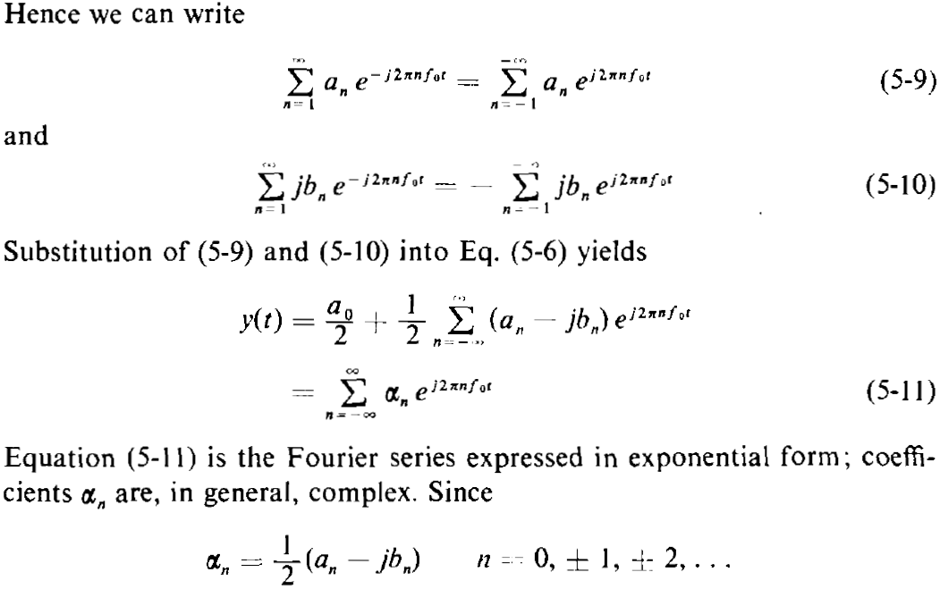
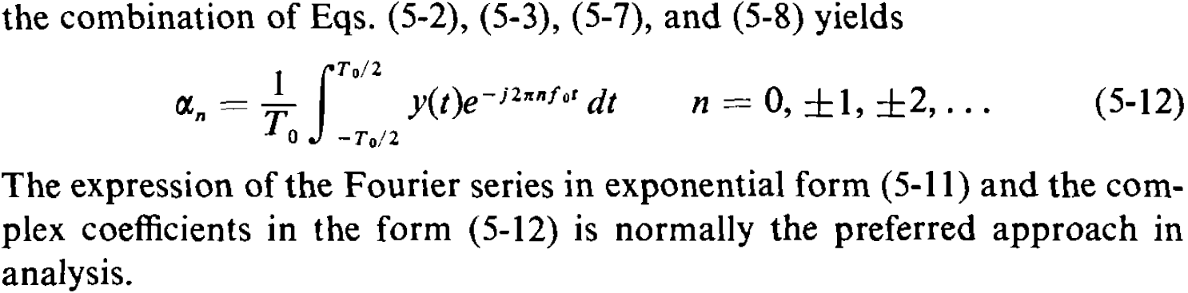

Slide 29
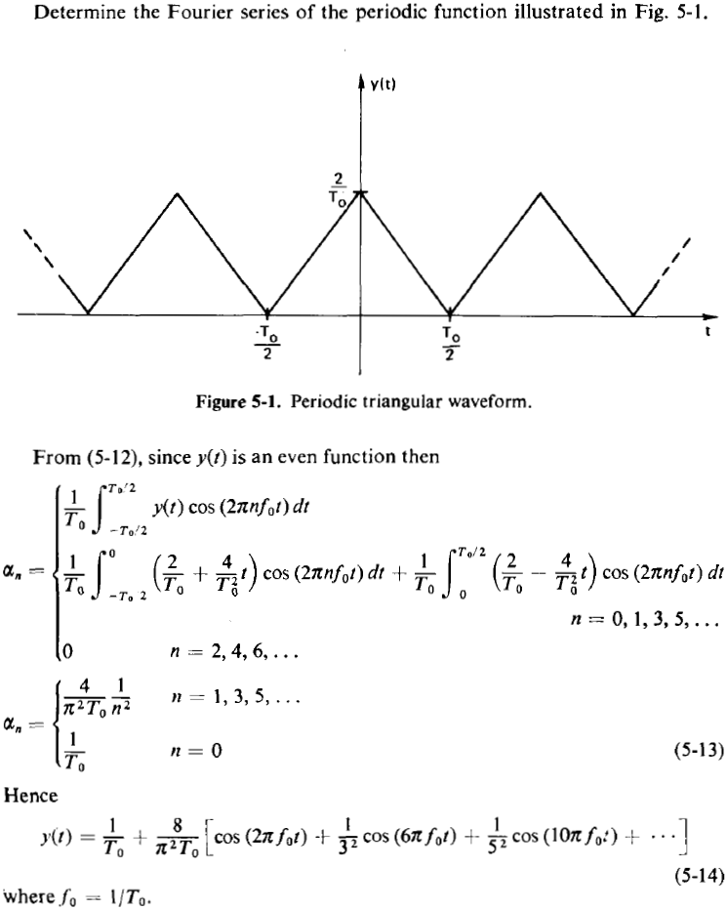
A Example of Fourier Series
Conclude: the Fourier series of a periodic triangular
Function as shown is an infinite set of sinusoids.

Slide 30
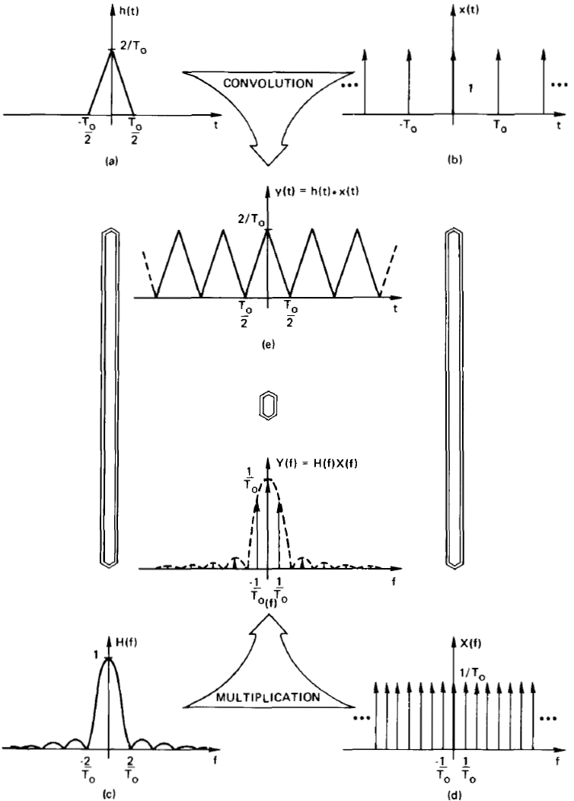
Fourier Series as a Special Case of the Fourier Integral
From the previous page, we know that the Fourier series of a periodic triangular function as shown is an infinite set of sinusoids. We will now show that an identical relationship can be obtained from the Fourier integral. To accomplish the derivation we utilize the convolution theorem. Note the periodic triangular waveform (period T₀) is simply the convolution of the single triangle and infinite sequence of equidistant impulses. From the convolution theorem, the desired Fourier transform is the product of the frequency functions of the above two functions. From the graph, we can tell that the Fourier transform of the periodic function is then an infinite set of sinusoids, which is consistent with the Fourier series.

Slide 31
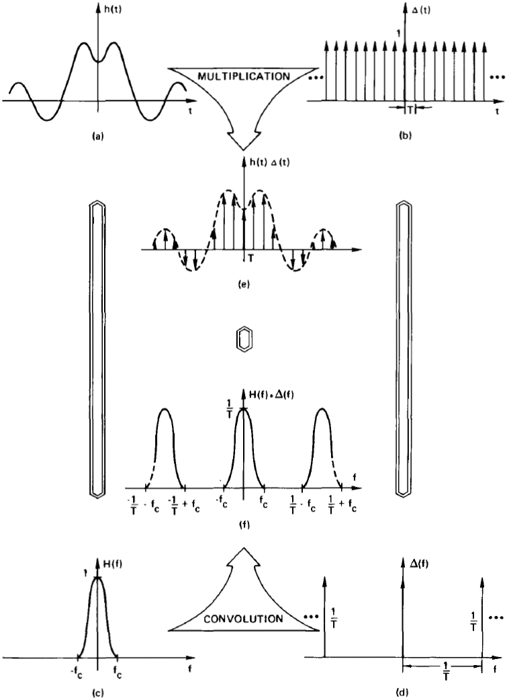
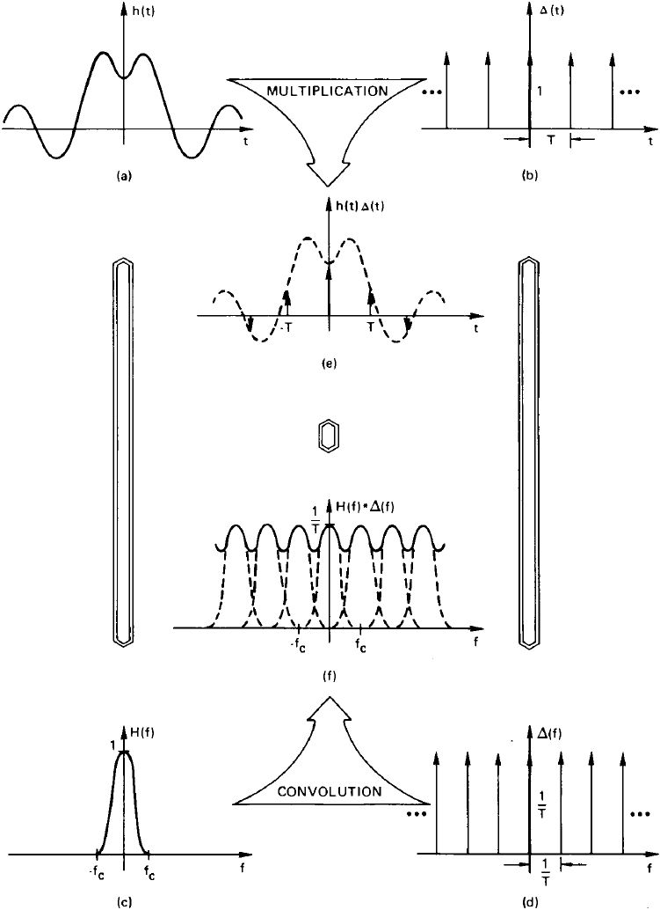
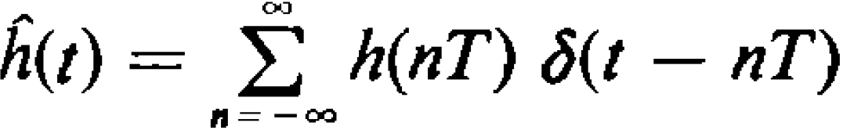
(2). Waveform Sampling
Aliased Fourier transform of a waveform
sampled at an insufficient rate

Slide 32
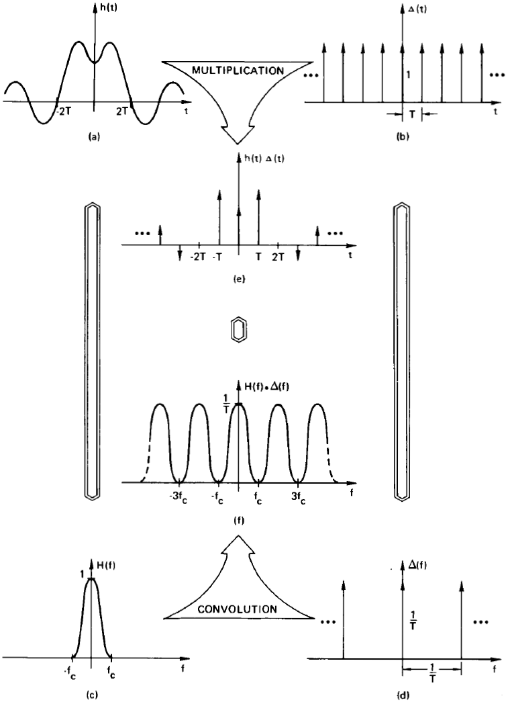
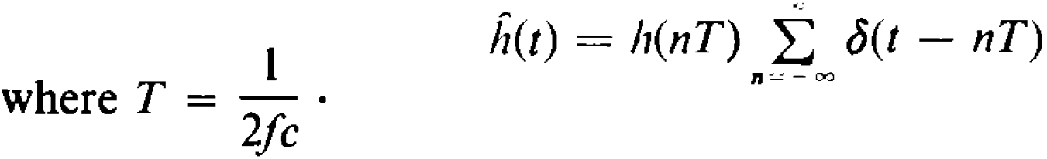
Sampling Theorem
Fourier transform of a waveform
sampled at the Nyquist sampling rate
Frequency 1/T=2f_{c} is known as the
Nyquist sampling rate

Slide 33
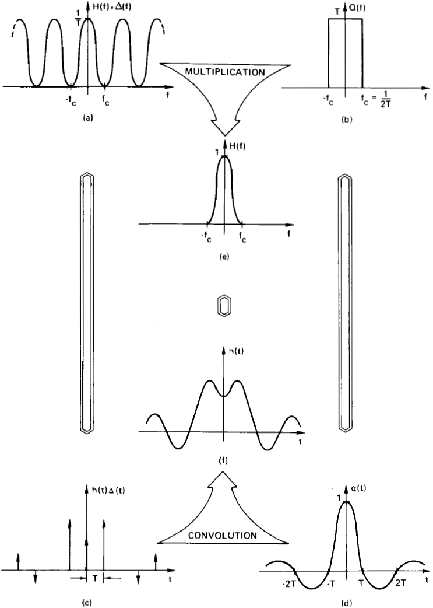
Graphical derivation of the sampling theorem

Slide 34
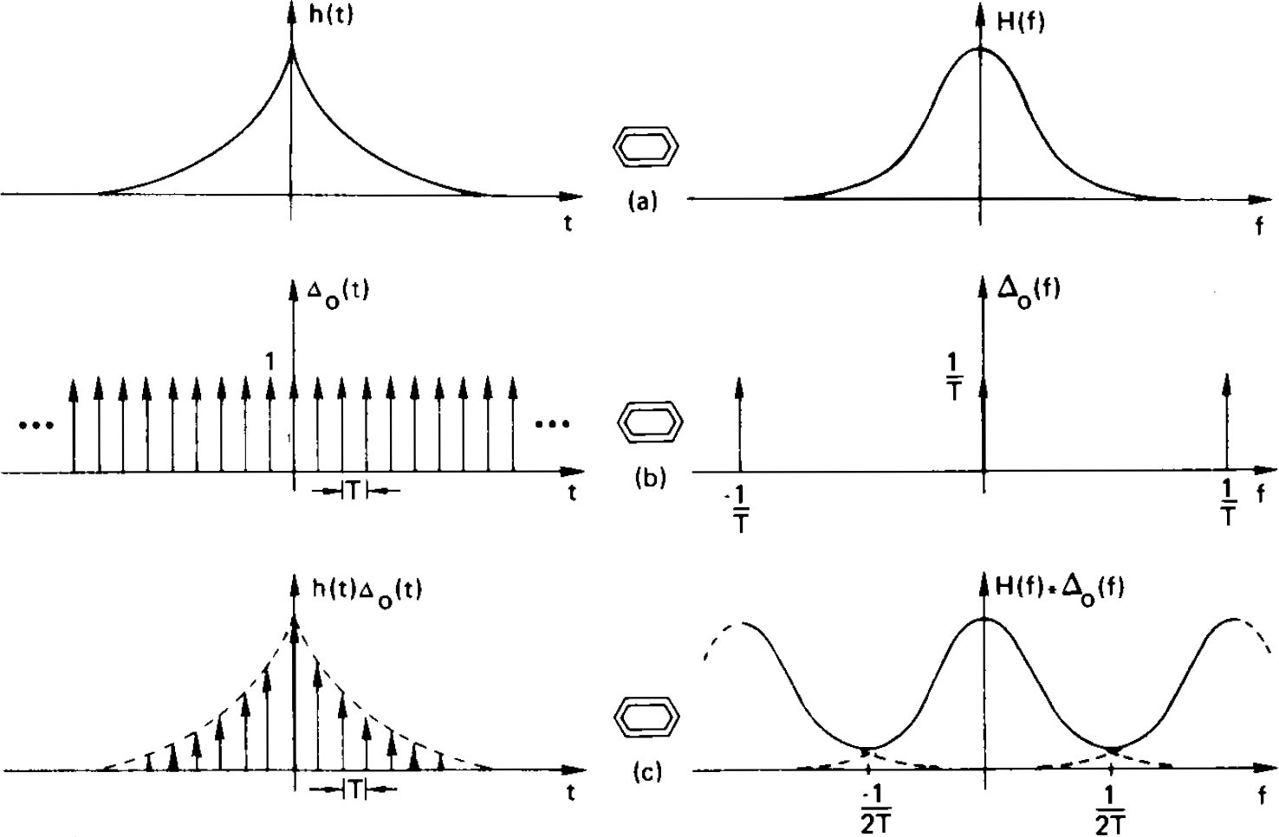
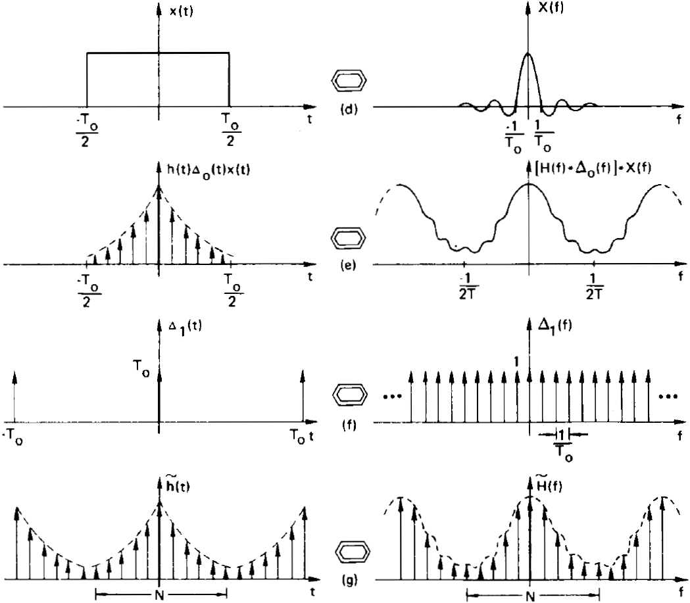
5. The Discrete Fourier Transform
Time domain sampling
Truncation
rippling
Frequency domain
sampling
aliasing
Note that sampling in the time/frequency domain resulted in a periodic function of frequency/time;
N time samples and N frequency values represent one period of the time and frequency domain waveforms, respectively.

Slide 35
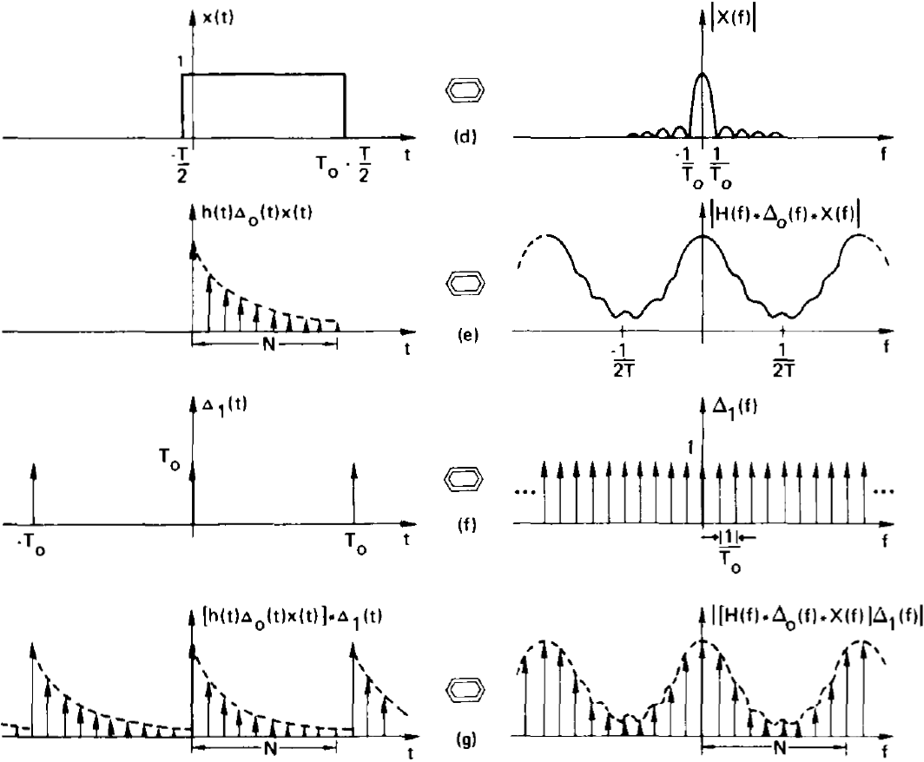
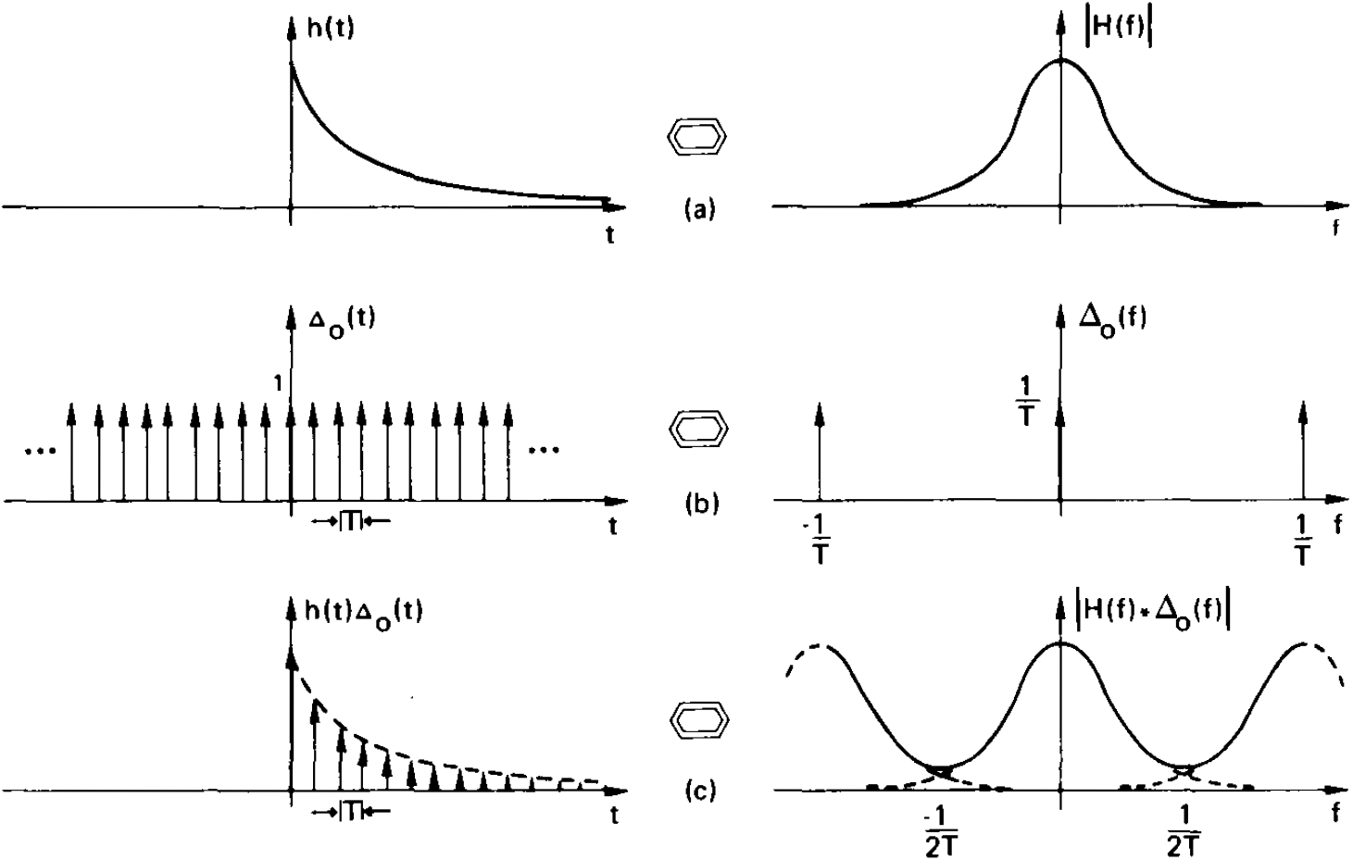
Another example of DFT

Slide 36


Relation between the Discrete and Continuous Fourier Transform
Band-Limited Periodic Waveforms:
Truncation Internal Equal to Period

Slide 37

Expanded illustration of
the convolution of step (e)

Slide 38


Relation between the Discrete and Continuous Fourier Transform
Band-Limited Periodic Waveforms:
Truncation Internal Not Equal to Period

Slide 39

Expanded illustration of
the convolution of step (e)
The sharp changes in the time domain results in
additional frequency components in the frequency domain shown in step (g)

Slide 40


Relation between the Discrete and Continuous Fourier Transform
Time-limited Waveforms
No need to truncate

Slide 41


Relation between the Discrete and Continuous Fourier Transform
General Waveforms

Slide 42


6. Discrete Convolution and Correlation (1). Convolution
Graphical description of discrete convolution shifting operation

Slide 43

Graphical discrete convolution
As in the convolution of continuous functions, either the sequence x(kT) or h(kT) can be selected for displacement. Equation (7-1) can be written equivalently as

Slide 44




Relationship between Discrete and Continuous convolution
Figure (b)/(c)/(d) illustrates the fact that discrete convolution results are scaled differently than that of continuous convolution. As illustrated in Fig. (e), if the sample interval T is made sufficiently small, then the error introduced by the discrete convolution is negligible.
Finite duration waveforms
There is no advantage in choosing N>P+Q-1

Slide 45


Relationship between Discrete and Continuous convolution
The two results agree reasonably well with the exception of the first Q-1 samples of the discrete convolution. (end effect，caused by aliasing attributed to x(t)’s last Q points)
Infinite and Finite duration waveforms

Slide 46



7. Applying the Discrete Fourier Transform to the computation of Fourier transforms and Fourier series
Those results for n > N/2 actually relate to negative frequency results.
The discrete transform approximates rather poorly the continuous transform for the higher frequencies. To reduce this error it is necessary to decrease the sample interval T and increase N.

Slide 47



Inverse Fourier Transform Approximation

Slide 48


Fourier Series Harmonic Analysis via the Discrete Fourier Transform
Reasonable results are obtained for the lower order harmonics. Accuracy can be improved for the higher harmonics by decreasing T and increasing N.
Note that we have introduced significant aliasing evidenced by the fact that the true coefficient values have appreciable magnitude at sample number n = N/2.

Slide 49


Fourier Series Harmonic Synthesis via the Discrete Fourier Transform
As shown, the results tend to oscillate about the correct value. These oscillations are due to the well-known Gibbs phenomenon which states that truncation in one domain leads to oscillations in the other domain. To decrease the magnitude of these oscillations, it is necessary to consider more harmonic coefficients; that is, increase N.

Slide 50
Leakage Reduction
We introduced the effect termed leakage which is inherent in the discrete Fourier transform because of the required time domain truncation. Recall that the truncation of a periodic function at other than a multiple of the period results in a sharp discontinuity in the time domain, or equivalently results in side-lobes in the frequency domain. These side-lobes are responsible for the additional frequency components which are termed leakage. In this section we will investigate the techniques for computing a discrete Fourier transform with minimum leakage.

Slide 51


Leakage Reduction
Discrete Fourier transform of a cosine waveform: truncation interval equal to a multitude of the period, no leakage

Slide 52


Leakage Reduction
Discrete Fourier transform of a cosine waveform: truncation interval not equal to a multitude of the period, leakage exist

Slide 53




Leakage Reduction
To reduce leakage, it is necessary to employ a time domain truncation function which has side-lobe characteristics which are of smaller magnitude than those of the sin(f)/f function. The smaller the side-lobes, the less leakage will affect the results of the discrete Fourier transform. Fortunately, there exist truncation functions which exhibit exactly the desired characteristics. For example, Hanning function.

Slide 54


Leakage Reduction
As expected, the leakage illustrated in Fig. (b) has been significantly reduced because of the low side-lobe characteristics of the Hanning truncation function. The non-zero frequency components are considerably broadened or smeared with respect to the desired impulse function.

Slide 55
7. Fast Fourier Transform (FFT) Convolution and Correlation
We just described the application of the discrete transform to the computation of the continuous Fourier transform. FFT is simply a procedure for rapid computing the discrete Fourier transform.
Applications of the FFT such as digital filtering, power spectrum analysis simulation, system analysis, communication theory, etc., are based, in general, on a specific implementation of the convolution or correlation integral or on using the FFT as an approximation to the continuous Fourier transform.

Slide 56


FFT Convolution of Finite Duration Waveforms
Example illustrating inefficient discrete convolution

Slide 57





FFT Convolution of Finite Duration Waveforms
Restructuring the Data
First shift both x(t) and h(t) to the origin. Let the shifts of x(t) and h(t) be a and b, respectively. Next, N is chosen to satisfy
The resulting sampled periodic functions are defined by the relationships

Slide 58

FFT Correlation of Finite Duration Waveforms
Example illustrating inefficient discrete correlation

Slide 59


FFT Correlation of Finite Duration Waveforms
Restructuring the Data
If we shift both functions to the origin as shown in Fig (a), then the resulting correlation is as illustrated in Fig (b). Although the correlation waveform is correct, it must be unraveled before it is meaningful. We can remedy this situation by restricting the waveform x(k) as shown in the next page.

Slide 60

FFT Correlation of Finite Duration Waveforms
Restructuring the Data again
We shift the P samples of x(k) to the extreme right of the N samples defining a period

Slide 61


FFT Convolution of an Infinite and a Finite Duration Waveform
Example convolution of an infinite and a finite duration waveform
We have discussed to this point only the class of function for which both x(t) and h(t) are of finite duration. Further we have assumed that N = 2^{γ} was sufficiently small so that the number of samples did not exceed our computer memory. When either of these two assumptions is false it is necessary to use the concept of sectioning.

Slide 62


Discrete convolution of each section
Reconstructed results of the discrete convolution of the left

Slide 63


Overlap-Save Sectioning
Overlap the sections of x(t) by (Q-1)T, which is the duration of the function h(t) minus T

Slide 64


Reconstructed results of the discrete convolution of overlapped sections of data

Slide 65

Overlap-Add Sectioning
Example illustrating proper sectioning for applying overlap-add discrete convolution

Slide 66


Reconstructed results

